Slide 1
CSD 1400 Project Introduction
Version Control
Version Control Theory
What we will be using

Slide 2
Version Control Theory

Slide 3

Version Control
What is version control?
A logical way to organize and control changes (revisions)
Captures historical data by tracking changes over time
Also known as revision control or source control

Slide 4

Version Control
Where is version control used?
books

Slide 5




Version Control
Where is version control used?
books
art

Slide 6
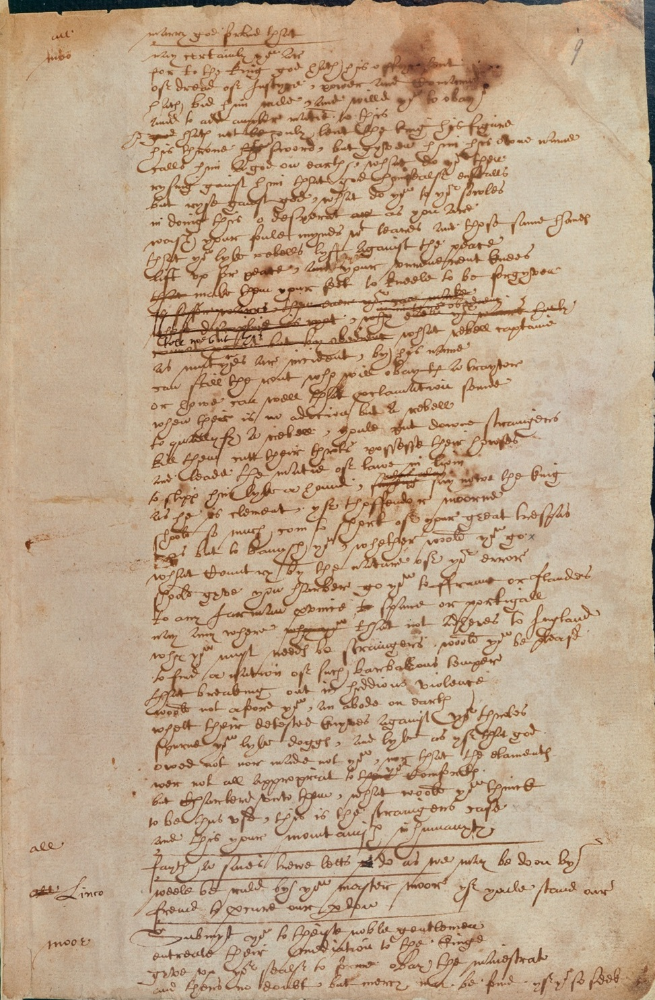

Version Control
Where is version control used?
books
art
other documents

Slide 7
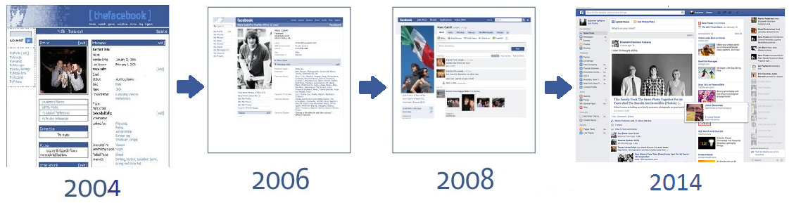
Version Control
Where is version control used?
computer programs
web sites
collections of data

Slide 8
Version Control
Version Control in Software Development
Simplest?
Multiple copies (USB, email)
Downsides
Lots of near-identical memory duplication
Easy to make mistakes
Easy to lose
Difficult to coordinate with team members

Slide 9
Version Control
USB method
USB is the source of truth (repository, read-only)
Copy the file to my machine (check out)
Make changes
Save changes back to USB as new version (check in, commit)
Overwriting the previous files is called clobbering

Slide 10
Centralized

Slide 11
Centralized model (SVN)
Repository is stored on a central server (single source of truth)
Users check out files
Make changes
Commit changes back to the server
File conflicts protected through locking or merging

Slide 12
Centralized model (SVN)
SVN Server

Slide 13
Centralized model (SVN)
SVN Server
1
1

Slide 14
Centralized model (SVN)
SVN Server
2
1

Slide 15
Centralized model (SVN)
SVN Server
2
2
1

Slide 16
Centralized model (SVN)
SVN Server
2
Conflict
1+
2

Slide 17
Centralized model (SVN)
SVN Server
3
Merge
1+
2

Slide 18
Centralized model (SVN)
Benefits
One protected source of truth
Server always has the Head revision
Simple to understand
Extensive historical information
Changes managed by the central system
Minimizes manual processes, less human error
Downsides
Older technology (CVS, 1990)
Must communicate with server, can slow down some operations

Slide 19
Distributed

Slide 20
Distributed model (Git)
Repository is stored on every user’s machine (many sources of potential truth)
Users make changes and commit to their own machine
Syncing with other users is done through push and pull

Slide 21
Distributed model (Git)
Distributed model (Git, Mercurial)
Peer
Server

Slide 22
Distributed model (Git)
Peer
Server

Slide 23
Distributed model (Git)
Benefits
Newer, improves on previous shortcomings (Git, 2005)
Everyone is their own repository
No central server, some operations are very fast
Downsides
Not as straight forward
Everyone is their own repository
No central server, some operations are very slow, no head

Slide 24
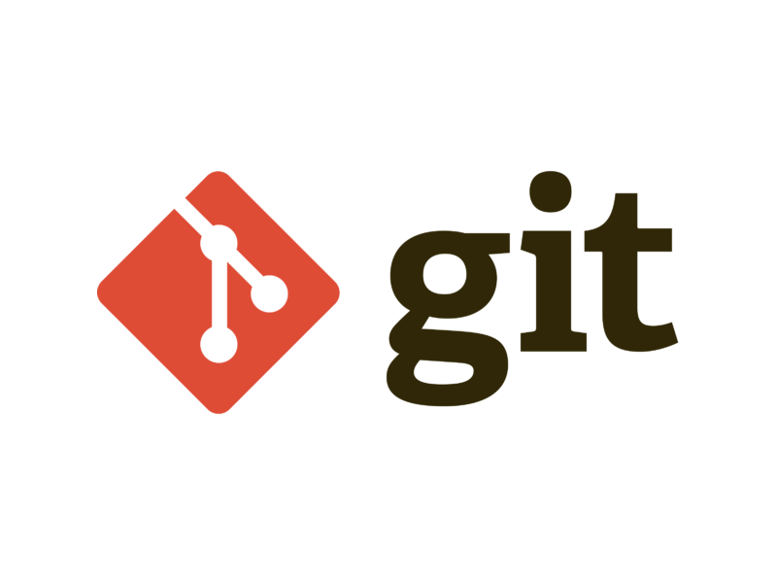
What we will be using

Slide 25
GIT
Version Control adopted by many companies
We will be adopting the Centralized Workflow
This leverages on the simplicity of SVN, while introducing the basics of GIT for more advance usage in the future.

Slide 26
Centralized Workflow
Similar to SVN Centralized Model
On the version control server, just 1 branch = 1 source of truth
Main difference, GIT provides local version control.

Slide 27
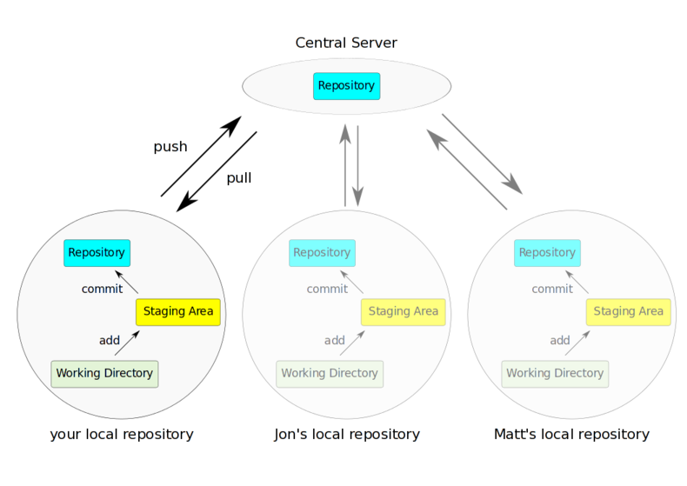

Slide 28
Reference
https://www.atlassian.com/git/tutorials/comparing-workflows#centralized-workflow

Slide 29
GIT Reality
Pain points for many
Very good skill to have

Slide 30
Credits
Original Lecturers using these slides:
Justin Chambers
Matthew Picioccio

